Slide 1


GET YOUR FINANCIAL LIFE IN GEAR
5 WAYS TO UP YOUR MONEY GAME TO CREATE YOUR WEALTH

Slide 2

5 SIMPLE STEPS
LESS STRESS
EASY BREEZY
IMPLEMENT UNDER –UTILIZED STRATEGIES
CREATE THE LIFESTYLE YOU DESIRE AND DESERVE!

Slide 3
WHY IS THIS IMPORTANT?
Nearly 80% of Americans live paycheck to paycheck – YIKES!
58% of Americans have less than $1,000 in savings
Good News and Bad News: Living Longer
One-fourth of working Americans have no retirement savings-WHOA!
Average Net Worth: Everything You Own MINUS Everything You Owe
$100,000 for ages 45-54
$180,000 for ages 55-64
$232,000+ for 65+.
WELL–
IN THE US, FINANCIAL HEALTH AND WELL BEING
ISN’T AS HEALTHY AS IT COULD AND SHOULD BE

Slide 4
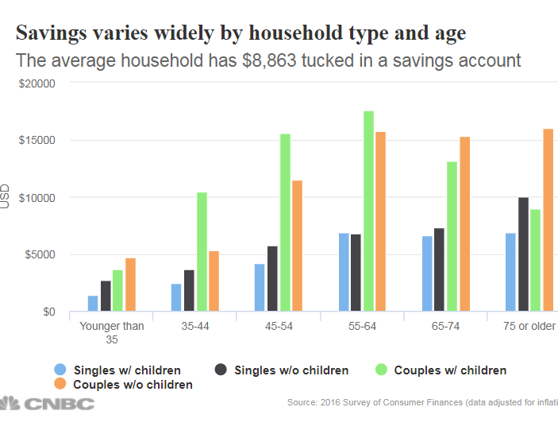

AVERAGE SAVINGS PER AMERICAN

Slide 5

FOR WOMEN
A BIGGER CHALLENGE
LIVE LONGER: Average life expectancy for women is 81 vs 76 for men. But for women age 65 now is 86 and for women aged 70 now, is 87 1/2 years
LESS WORKING YEARS: On average spend 9 less years working due to family responsibilities
LESS PAY: Women earn 21% less than men
LESS ENGAGEMENT IN FINANCIAL HEALTH
AVERAGE AGE OF WIDOWHOOD IS 59: 80% of men die married, 80% of women die single
Notes:
Live longer ess pay, which translates into less paid into retirement plans

Slide 6

WHAT PEOPLE FEEL
AND WANT
Good intentions
Too many intentions
No intention of changing: Lip Service

Slide 7

WHAT WE’LL COVER TODAY
CONSCIOUS = CONSCIENTIOUS
LOOK AT THINGS DIFFERENTLY
USE WHAT YOU HAVE ALREADY
Be Attentive
Create Accountability
How will your financial decisions today affect your future?
Just do it differently
Thinking and doing for today and tomorrow
KISS IT: Keep It SIMPLY SIMPLE
Your Employee Benefits can be a key component to building your wealth
Think outside the Box

Slide 8


KNOW WHAT’S COMING IN AND
WHAT’S GOING OUT
There’s got to be more! The last time I checked there was…..
WHAT THE HECK??

Slide 9

TIP #1
TRACK YOUR $ IN REAL TIME
ACCOUNTABILITY: USE VIRTUAL APPS
Wally:
https://wally.me
Mint
https://www.mint.com/
Personal Capital:
https://www.personalcapital.com/
Pocketguard:
https://pocketguard.com/
Notes:
AT UWM, Our clients get a personalized financial dashboard to assist in providing accountability and real time feedback about spending. Example: had a client who expressed a desire to improve her cash flow. We had a meeting scheduled and I checked on her cash flow tab and saw she has spent about $800 on a pair of shoes- called her and recommended that she take those shoes back!

Slide 10

TRACKING CASH FLOW IN REAL TIME IS KEY!
FINANCIAL AWARENESS WILL HELP CREATE FINANCIAL FITNESS
SET ALERTS- OOPS!
HELPS WITH THE “B” WORD
CONSIDER THE 50/30/20 RULE
CAN ASSIST WITH CYBER AND SPAM ATTEMPTS
TRY THIS AS A PROJECT: HMMMM…
Notes:
SPAM ATTEMPTS – HAD A CLIENT WHO NOTICED ON HIS FINANCIAL DASHBOARD THAT CHARGES WERE MADE TO HIS AMEX
BY SETTING ALERTS, YOU’LL BE ALIGNED WITH WHAT YOUR SPENDING IN REAL TIME. YOU CAN EVEN AWARD YOURSELF IF YOU HAVENT’ EXCEEDED YOUR BUDGETED CATEGORY
CARD THE DAY AFTER THE TRANSACTION TOOK PLACE– WHICH HE DID NOT DO. HE WAS ABLE TO CONTACT THE CREDIT CARD COMPANY TO DECLINE AND CHANGE HIS CC NUMBER/ACCOUNT
TRY THIS AS A PROJECT: WRITE DOWN WHAT YOU BELIEVE TO BE YOUR MONTHLY EXPENSES. THEN COMPARE THEM TO WHAT HAS ACTUALLY BEEN SPENT ONCE YOU’RE ON ONE OF THE APPS – OR WHEN YOU DOWNLOAD THE SPREADSHEETS/REPORTS FROM YOUR BANK FOR THE PAST 6 MONTHS. SEE IF THE NUMBERS ARE ALIGNED. IF THEY ARE- CONGRATS- IF NOT, NOW IS THE TIME TO MAKE A CHANGE

Slide 11
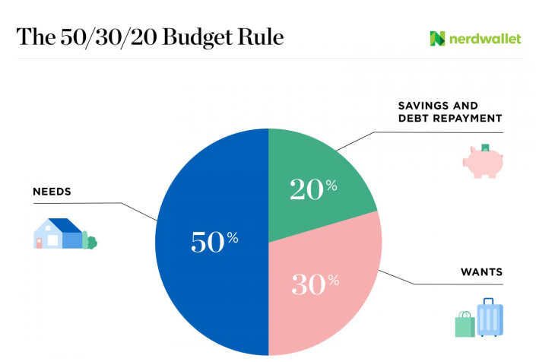
KEEP TRACK AND CONTROL
WHAT GOES WHERE?
1) WHAT YOU GOTTA SPEND:
NON-DISCRETIONARY
2) PAY YOURSELF:
SAVINGS AND “RAINY DAY”
3) WHAT YOU WANT TO SPEND:
DISCRETIONARY

Slide 12


TIP#2
GET ON THE TAX PLANNING TRAIL

Slide 13


TAX DEDUCTIBLE– YEP !
TAX-DEFERRED-OH YEAH !!
TAX FREE YAY-YAY-YAY !!!

Slide 14

401K PLANS:
YOUR EASY BREEZY TOP PICK
WEALTH BUILDER
2020 UPDATES
DOES IT MATTER? Employer match or not
TAX IMPACT: Pre-tax reduces your taxable income, but after-tax or Roth contributions – not. BUT….
TURNING 50 IN 2020? Sign up for Catch Up
TAKE YOUR NICKLES AND DIMES: When you change employers, don’t leave your money behind.
Notes:
I KNOW YOU HEAR THIS ALL THE TIME – FUND YOUR 401K PLAN. YES INDEED! For many folks, this plan is a key component of not only their retirement/3rd Act planning, but is a wealth builder too. Off, be aware of what lies ahead and general rules. For 2020, as many of you know, the limit have increased from $19000 to $19500 and for the catch up section, its gone up from $6000 to $6500.

Slide 15
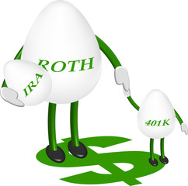
ONE PATHWAY TO TAX FREE:
DROP $ INTO YOUR ROTH 401K
Here’s What You Need to Know:
Always funded with after tax money. Employer match goes into pre-tax 401k account.
No earnings income limitation vs. Roth IRA’s
5 -Year Rule
Distributions are tax-free to owner AND to beneficiaries- subject to certain rules
If you leave money in 401k after leaving, there are requirements to withdraw funds: RMD rules. So, move it to a Roth IRA
Notes:
TWO VERSIONS OF ROTHS- ALWAYS FUNDED WITH AFTER TAX $-BUT THE RULES ARE DIFFERENT.
VS. 401K TRADITIONAL, WHICH IS AS YOU KNOW IS FUNDED WITH PRE-TAX $.
Income limitations for funding Roth IRA’s, for 2020 for singles the income earnings limit is $124,000- if its between $124K and $139K, you can make a reduced contribution. For those filing jointly, the income limitiation is $196,000- if between $196 and $206K – you can still contribute but at a reduced level.

Slide 16

TIP#2
GET ON THE TAX PLANNING TRAIL

Slide 17
TIP#3
PATHWAY TO TAX FREE IS ROTH ANYTHING
ROTH IRA PLANS
Can be funded by Roth 401k rollover, after tax 401k monies, converting a traditional IRA to Roth or direct funding.
Direct Contributions are subject to income/wages limitations. In 2020, maximum MAGI for filing single is $124,000 and for filing jointly, $196,000
No cutoff date for funding the Roth IRA as long as you have wages.
If you can’t fund a Roth through the front door – (income is too high), go through the Back door
RULE: Contributions can be taken out at any time – no taxes or penalties, regardless of age! Special rules for accessing earnings tax free – however.
ROTH 401K PLANS
Not subject to wages/income limitations
Retain Employer match
Can contribute to the pre-tax as well as the Roth 401k subject to maximum limits. In 2020, the maximum base is $19,500, including the catch-up the maximum contribution is $26000
At separation of service, can roll over into a Roth IRA
Also, after tax (non-Roth $) can be rolled into a Roth IRA- no taxes.
CAUTIONARY NOTE: When separating from service, be sure to consult with your financial planner and/or tax advisor to identify if you have after tax or Roth 401k monies. The rules are different for rolling these over into a Roth IRA.
Notes:
Cautionary Note

Slide 18

SIMILARITIES AND DIFFERENCES
ROTH 401K RULES VS. ROTH IRA RULES
ROTHs come in two versions: 401k and IRA
Both are always funded with after tax money.
Earnings limitations for Roth IRAs, NONE for 401k Roths
5- year rules apply to both-BUT- there’s a difference
Always have access to your contributions with Roth IRAs. Access to Roth 401ks? Special rules apply!
* Earnings can be withdrawn tax free from Roth 401k and Roth IRA’s – subject to certain rules.
WHOOP WHOOP! Distributions are tax-free to owner and to beneficiary(ies)
Notes:
SAME BUT DIFFERENT RULES: TWO VERSIONS OF ROTHS- ALWAYS FUNDED WITH AFTER TAX $-BUT THE RULES ARE DIFFERENT.
VS. 401K TRADITIONAL, WHICH IS AS YOU KNOW IS FUNDED WITH PRE-TAX $.
Income limitations for funding Roth IRA’s, for 2020 for singles the income earnings limit is $124,000- if its between $124K and $139K, you can make a reduced contribution. For those filing jointly, the income limitation is $196,000- if between $196 and $206K – you can still contribute but at a reduced level. There are no income limitations with the Roth 401k-

Slide 19

TIP #4
HEALTH CARE PLAN OPTIONS
Some Plans are not just for today’s health planning but for your future needs.

Slide 20


Slide 21

Pre-Tax contributions: State and Federal
Two different types of plans: Health and Dependent Care
Employer Match
Use it or lose it!

Slide 22

HSA:
HEALTH SAVINGS ACCOUNTS TRIFECTA!!
Excellent planning vehicle for current AND future health care related expenses
Tax deductibility: Contributions are federally tax-deductible. State deductibility depends on what state you are in – in Cali? Ahhhh – Nope.
Employers can match Health Savings Accounts
Must be paired with a Qualified HDHP-
HSA’s are portable.
No use it or Lose it.
Contribution limits are higher
Can Invest your Money

Slide 23
RECAP
FSA
Employer Provided and can be employer matched
Distributions are tax-free if used for health- related expenses
Tax – deductible contributions
Use it or Lose it- can rollover $500 into next year
Not portable
2020 Max: $2750
HSA
Employer Provided and can be employer matched
Tax-deductible contributions, distributions are tax-free if used for health –related expenses
Must be paired with a HDHP of at least $1300 for singles; $2600 for family plan. Has higher contribution limits: $3400+$1000 catch up; $6750+1000 catch up.
No use it or lose it AND can invest funds
Portable
Unused funds can remain in account and be used for medical expenses and/or non-medical expenses after age 65. An additional retirement income fund!

Slide 24
RECAP
FSA
HSA
Employer Provided and can be employer matched
Distributions are tax-free if used for health- related expenses
Child and/or Adult Day Care plan options
Tax – deductible contributions
Use it or Lose it- can rollover $500 into next year
Not portable
No investments
2020 FSA Health Plans: $2750/Child-Adult Day Care: $5000
Employer Provided and can be employer matched
Tax-deductible contributions, distributions are tax-free is used for health –related expenses
Must be paired with a HDHP of at least $1300 for singles; $2600 for family plan. Has higher contribution limits: $3400+$1000 catch up; $6750+1000 catch up.
No use it or lose it AND can invest funds
Unused premiums remain in the account and are withdrawn tax free for qualified medical expenses and if not used for medical expenses after age 65, can be accessed for non-medical expenses and is taxed as regular income. It becomes another retirement plan!

Slide 25

TIP #5
GET YOUR TEAM IN PLACE
YOU’RE THE CEO
CREATE YOUR “CORPORATE” TEAM
ACCOUNTANT/TAX PLANNER
FINANCIAL PLANNER/ FINANCIAL ADVISOR
ATTORNEY
INSURANCE PROFESSIONAL

Slide 26

YOUR TEAM’S OBJECTIVES? YOU!
EVERYONE NEEDS TO BE ON THE SAME PAGE: YOURS
CONNECT THE DOTS
BEST WAY TO FIND THEM? REFERRALS
BACKGROUND CHECKS

Slide 27
DUE DILIGENCE/ BACKGROUND CHECK
PROFESSIONALS
Insurance Professionals
Financial Planners/Advisors
Investment Advisors
Attorneys
Accountants
WEBSITE CHECK-INS
Insurance.ca.gov
Advisorinfo.sec.gov
Brokercheck.finra.org
Members.calbar.ca.gov
Dca.ca gov/cba/consumers

Slide 28
“SECURE ACT:
Setting Community Up for Retirement Enhancement
RMD Age Change: 70 ½ to 72
Inherited IRA beneficiary rules change
IRA Contribution Rules based on age
Withdrawal from retirement accounts for newly born or adopted children
529 Plan – Student Loan Debt Payout

Slide 29
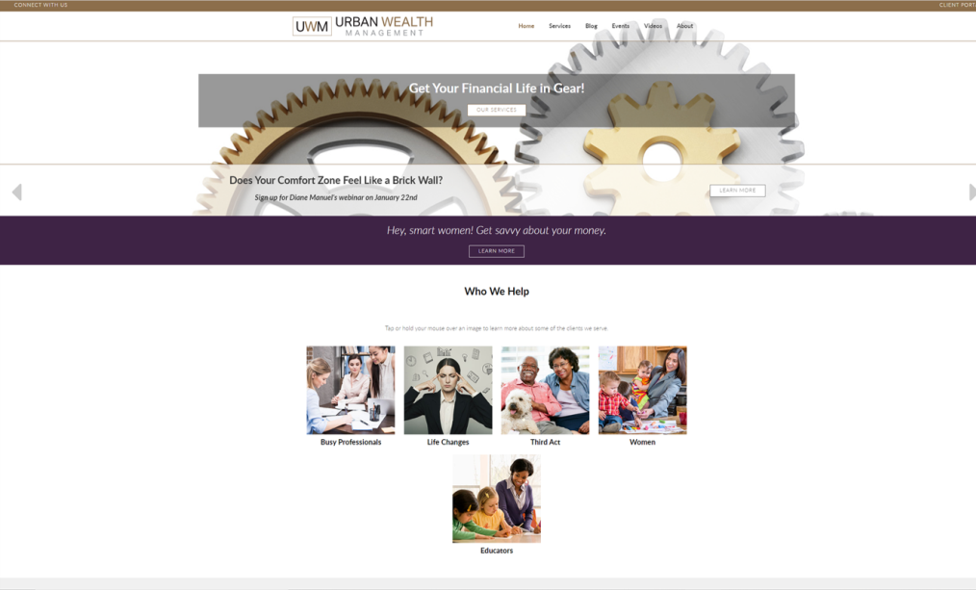
www. Urbanwm.com

Slide 30

QUESTIONS?

