Slide 1
The War for Talent & How to WIN!
Rachel Williams
CEO & Founder
Miller Harper Williams

Slide 2
Agenda
A Little About Me
What Top Companies Get Right
Employer Brand
Inclusive Recruiting Strategies
Exercise: Audit of Our Organization’s Employment Brand
Talent Spotters - ABC Alway Be Recruiting
Questions

Slide 3








About Me
Notes:
Born and raised in San Mateo CA
High school in Hillsborough - exclusive neighborhood
Told I was there to get an education but that I was a part of a program to diversify the school
Cal grad
Silicon Valley for 20+ years
Yelp, Peet’s Coffee&Tea, StubHub/eBay
Spoken at the White House in 2016, Stanford Business School, Wharton Business School and Harvard - only school that hasn’t invited me to speak is Cal???

Slide 4
Who Do You Want To Hire?
Diversity - Gen Z is most diverse generation in our country’s history
Technology - Very dependent; can’t remember a time without it
Parenting - Getting married & having children later
Gen Z
Millennials
Gen X
Baby Boomers

Slide 5
What Top Companies Get Right
Employer Brand
Inclusive Recruiting Strategies

Slide 6
Employer Brand

Slide 7
The Components of A Strong Employer Brand
Online Presence
Conferences
Corporate Social Voice

Slide 8
Online Presence
Website
Social Platforms
Job Descriptions
What people images are being displayed?
How easy is it to find your jobs?
Do you have a careers/culture page?
Where is your diversity & social responsibility listed?
Facebook
Instagram
YouTube
LinkedIn
Glassdoor
Advanced: Snapchat, TikTok
Gender neutral language
EEO statement (do better!)
Culture description at top
Where are you posting?
Is every employee empowered to share?

Slide 9
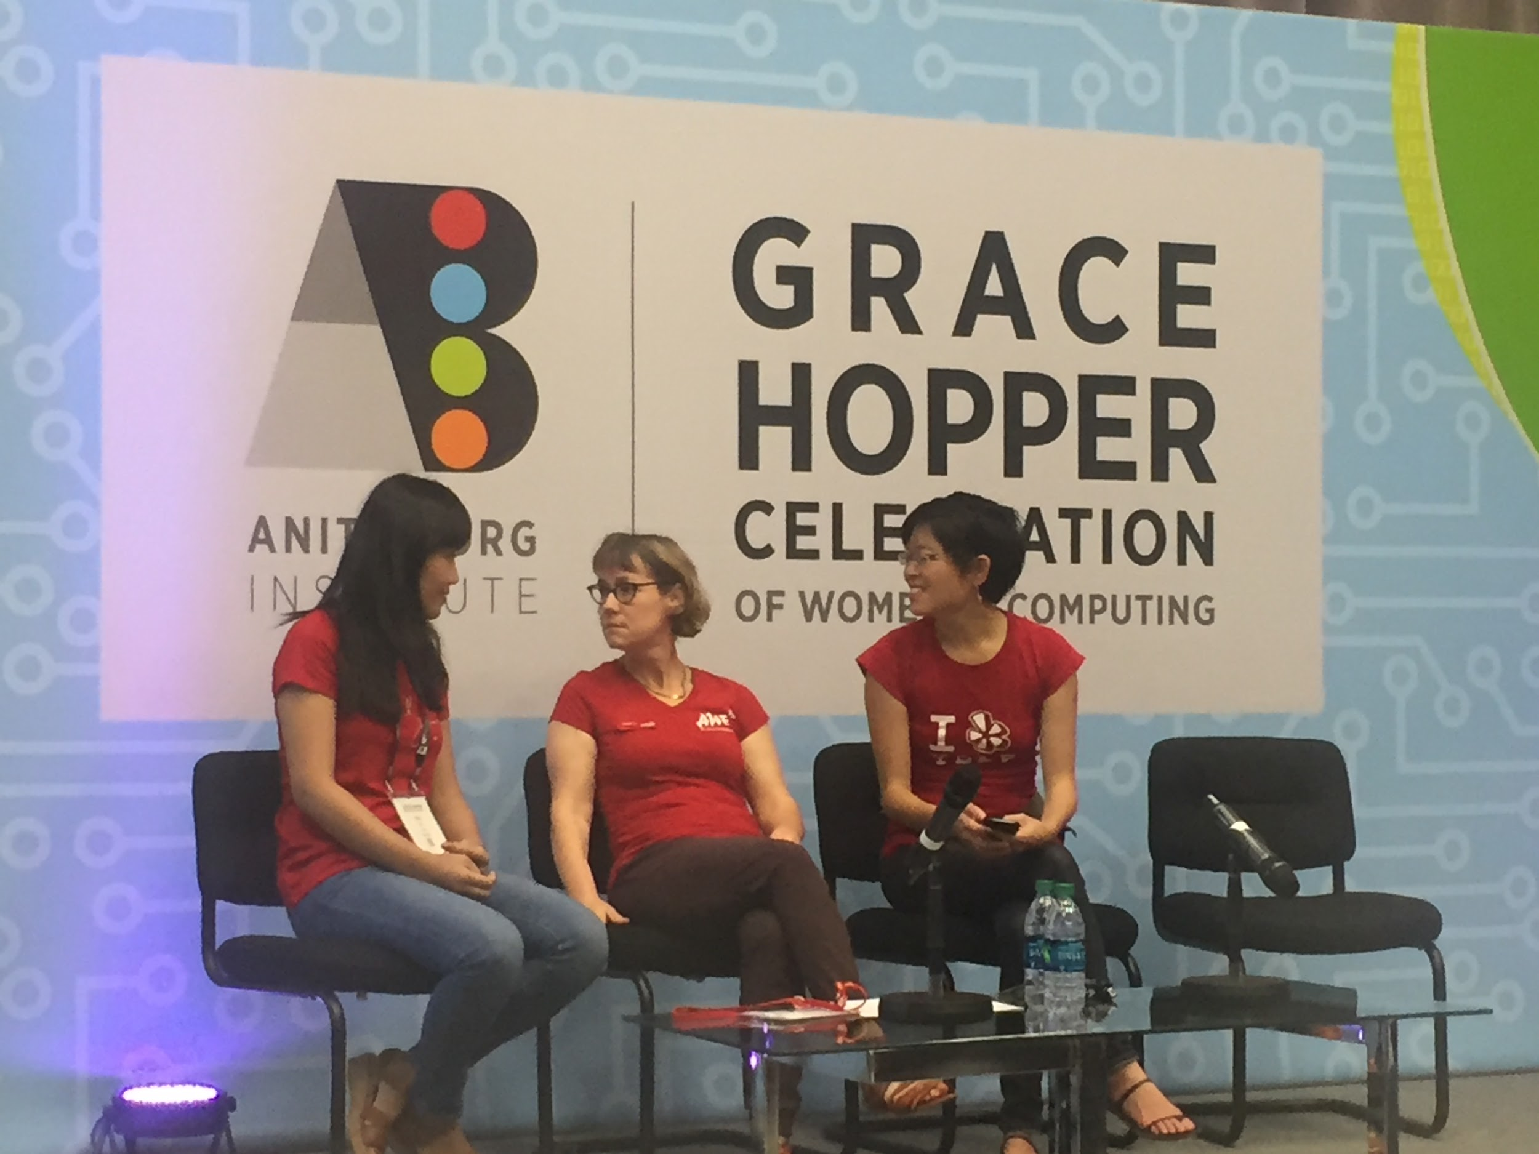
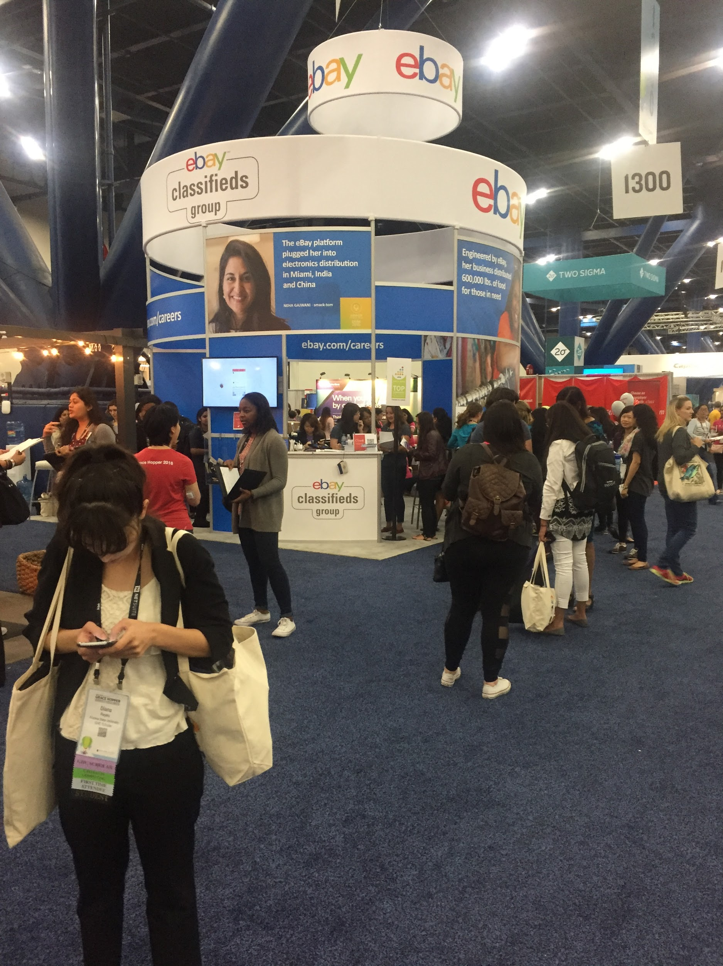
Conferences

Slide 10
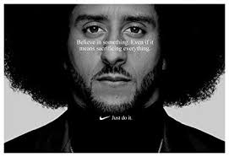
Corporate Social Voice

Slide 11
Inclusive Recruiting Strategies

Slide 12
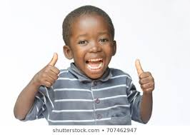


Candidate Experience
Follow Up
Community Building

Slide 13
Which organizations have you lost candidates to?
Which companies do you admire?
Exercise
Discuss
What did you notice about their websites, social media?
Can you tell what social issues are important, if any?
What are some ways that your own organization can improve?
Look at their online presence: website, social media accounts.
Look at your own organization’s online presence.

Slide 14
Talent Spotters - Everyone is a Recruiter
Values
Wins
Principles
Culture
Vision
Mission
Always. Be. Recruiting.
Notes:
Google, Facebook Hire Diversity & Inclusion Leader...

Slide 15
Questions, Insights, Comments

Slide 16

Thank you.

Slide 17
Twitter: @heymsrachel
LinkedIn: www.linkedin.com/in/rachwill

