Slide 1
Substance Use and Mental Health Disorders in the Legal Profession:
The Facts and The Path Forward
Lisa Smith, Esq.
ALA Golden Gate K2L
January 30, 2020

Slide 2
Agenda
Personal story
What are the facts?
  2016 ABA/Hazelden Betty Ford study
How do we go forward?
  ABA Task Force’s Path to Lawyer Well-Being and Pledge Challenge

Slide 3
ABA National Task Force On Lawyer
Well-Being: Why Now?
The Prevalence of Substance Use and Other Mental Health Concerns Among American Attorneys
  P.R. Krill, R. Johnson, & L. Albert
  10 J. Addiction Med. 46 (2016)
Suffering in Silence: The Survey of Law Student Well-Being and the Reluctance of Law Students to Seek Help for Substance Use and Mental Health Concerns
  J.M. Organ, D. Jaffe, K. Bender
  66 J. Legal Educ. 116 (2016)

Slide 4
2016 ABA Lawyer Study

Slide 5
Mental Health Issues
28% reported depression
19% reported severe anxiety
11.5% reported suicidal thoughts during career

Slide 6
Young Lawyers at Risk
Lawyers in their first ten years of practice reported highest rates of:
  Substance Use Disorder
  Depression
Older lawyers reported the lowest rates
Opposite of current perception

Slide 7
Barriers to Seeking Help
Not wanting others to find out they needed help
Concerns regarding privacy or confidentiality
Perpetuate the STIGMA that must be broken

Slide 8
ABA Task Force Report
“The Path to Lawyer Well-Being: Practical Recommendations for Positive Change”
  Focused on impairment and well-being
  Addressed to legal stakeholders:
      Judges
      Regulators
      Legal Employers
      Law Schools
      Bar Associations
      Professional Liability Carriers
      Lawyers Assistance Programs

Slide 9
ABA Pledge to Advance Lawyer Well-Being
In September 2018, the Task Force challenged legal employers to take a pledge committing to the advancement of lawyer well-being.
  Provide enhanced and robust education on these issues
  Disrupt the status quo of drinking-based events
  Develop visible partnerships with outside resources
  Provide confidential access to addiction and mental health experts
  Develop proactive policies and protocols around these issues
  Demonstrate the health-seeking and self-care are core cultural values
  Highlight the adoption of this well-being framework

Slide 10
Three Reasons to Take Action
Humanitarian concern — untreated mental health and substance use disorders ruin lives and careers.
Organizational success—in law firms, corporations, and government entities.
Well-being influences ethics and professionalism.
    Rule 1.1 – competence
    Rule 1.3 – diligence
    Rules 4.1 through 4.4 – transactions with persons other than clients

Slide 11
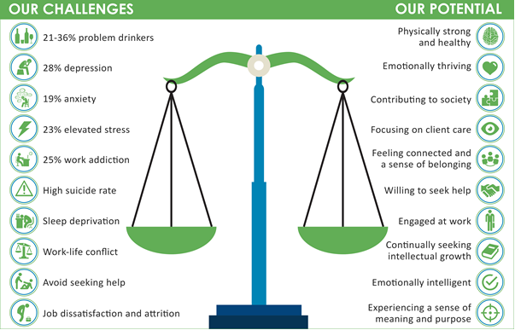

Slide 12
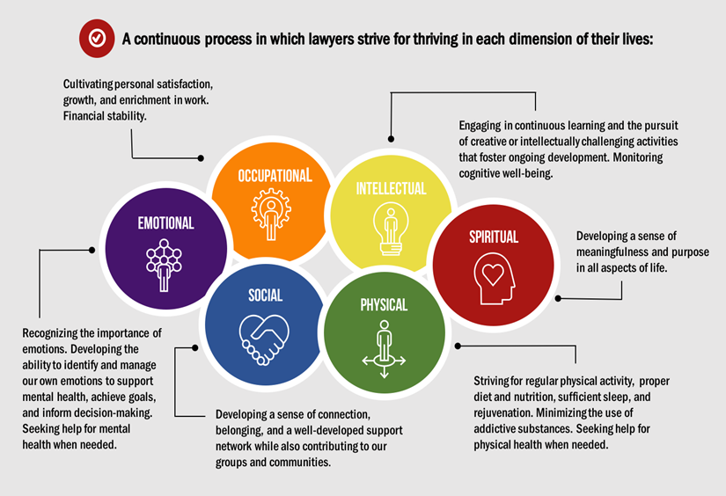
What is Lawyer “Well-Being”?

Slide 13
Contact Me
  Lisa Smith
  lisasmithadvisory.com
  lisasmithadvisory@gmail.com

