Slide 1


Today’s Trends in Legal Support Staffing

Slide 2


Objectives
Legal support trends
Open discussion about trends
and best practices

Slide 3


Where we have been…

Slide 4

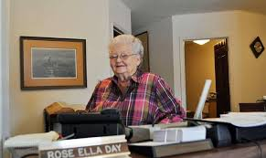
Where we have been…

Slide 5

Factors Affecting Legal Staffing
Changes in the legal industry
  Client pressures
  Artificial intelligence
  Technology
Candidate market
  SF Bay are unemployment rate at 2.2%
  Low-rent locations
Multi-Generational workforce
  Aging workforce

Slide 6
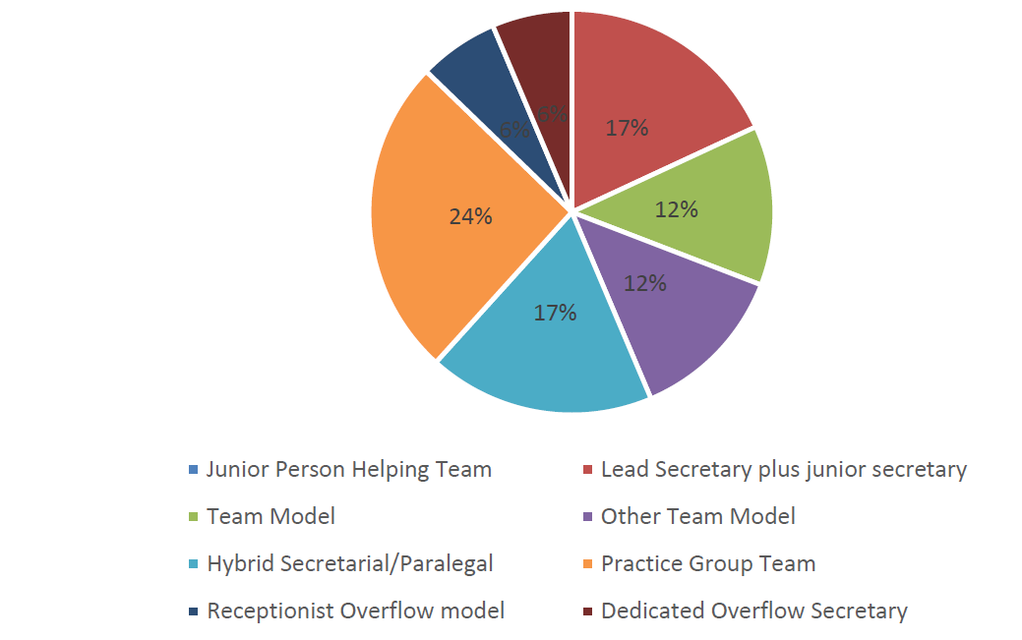
Staffing Models

Slide 7
Staffing Models
Jones Day
  Pairs – Senior secretary and Lawyer Support Assistant supports 10-15 people
  Pairs and individual secretaries form Support Center (5-6) that provides backup coverage
  Coverage over 10 hours with staggered start times
  All US Offices
Gibson Dunn
  1st – 3rd year attorneys supported by team
  4th plus can be assigned upon request
  4 secretaries for 60
Morrison & Foerster
  1st – 3rd year attorneys supported by “STARS”
  60 associates for 5 secretaries in STARS setup
  One pool for litigation and business departments
  Work comes into STARS email inbox
Proskauer
  1st and 2nd year attorneys supported by team
  4-6 secretaries per team
  Work comes in through central inbox

Slide 8
Benefits of the Team Structure:
The Business Case
  Cross-trained support provides continuity of coverage over longer periods of time
  Teaming allows for greater expertise in a wider variety of areas (e.g., each team members specializes in a particular skill set, but is proficient in all)
  Significant salary savings in staffing teams at a variety of levels of experience
  Promotability within team structure provides career path for entry-level employees
  Team members better understand that they work for the firm, not a particular partner who might hold the employee to a lesser standard
  Performance deficiencies and areas for improvement are quickly identified
  “Partner first” mentality is minimalized or eliminated with no disruption in service

Slide 9
Developing High Performing Teams
Standardization of work product throughout practice groups
Geography: Team needs to sit together for maximum efficiency
Identify areas of expertise for each team member and support learning initiatives
Provide opportunities for best practices to be shared among support teams
Create growth opportunities within the team structure
Forming-Storming-Norming-Performing

Slide 10
Voluntary Retirement Programs
Morgan Lewis:
  Voluntary buyouts to its legal secretaries in the US
  Two weeks’ pay for each year of service, capped at 52 weeks
  Other law firms: Six-month cap
Blank Rome LLP
  About 30 secretaries took buyouts. 10 technology specialists were assigned to support junior lawyers across the firm’s 10 domestic offices
Weil, Gotshal & Manges LLP
  Reduced about 110 staff positions, including about 60 legal secretaries
Crowell & Moring LLP
  29 secretaries took a voluntary buyout: Six months of annual salary

Slide 11

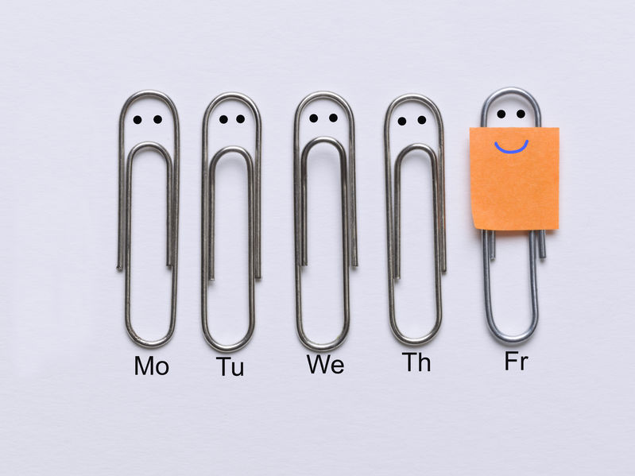
Alternative Work Schedules
  Part-time
  Compressed Week
  Job-share

Slide 12
Succession Planning
Lack of talented and experienced secretaries in the job market
“Secretary” stigma - growth opportunities and professional development
  College graduates looking to gain experience in professional setting
  Technology skills and adaptability
  Project management aptitude
  Expected to stay in roles for just a few years
  Pay is often half of a legal secretary
  Training program

Slide 13


Remote Work
  Work from home
Hogan Lovells:
  Agile work
  After 90 days
  Approval partner/group leader
  Written request (not childcare)
  Supply laptop, mouse, headset
  1 day a week and partial (e.g. doctors)
Outside major metropolitan areas
Centralized operations

Slide 14
Job Titles
Legal Secretary Alternatives
  Legal Assistants (CLE training requirement) – Duane Morris
  Legal Practice Assistant – Perkins Coie
  Legal Support Team Specialist - Husch Blackwell
Entry Level Job Titles
  Practice Team Assistant – Cooley
  Lawyer Support Assistants – Jones Day
  Client Service Specialists – Reed Smith
  Legal Resource Assistant – Arnold Porter
  Legal practice assistants and administrative practice assistants – Morgan Lewis

Slide 15
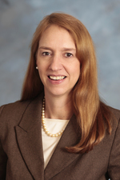
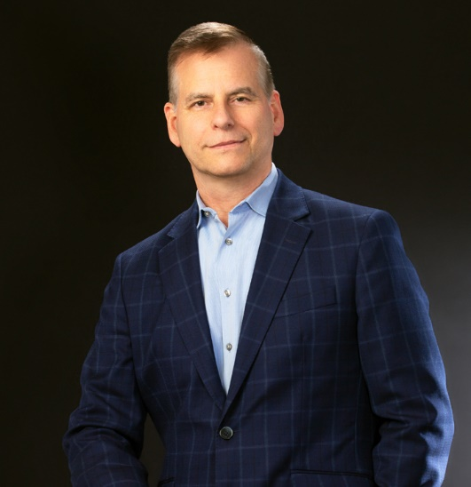
Meet Your Presenters
Jennifer Kay Connon, CLM, MBA
Senior Consultant
DLC Consulting Services
415-404-5241
jennifer@dlccs.com
Steven M. Morris, CLM, SPHR, SHRM-SCP
Director of Administration
Cooley LLP
101 California Street, 5th Floor
San Francisco, CA 94111
415-693-2010
smorris@cooley.com
www.cooley.com

